Slide 1
ADULT DATA
ANALYSIS, LOGICAL REGRESSION, CROSS-VALIDATION, COLLISION MATRIX

Slide 2
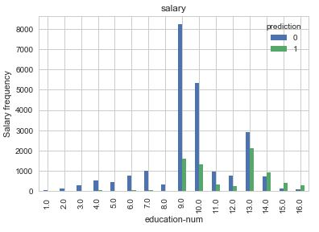
SALARY salary frequency vs education-num

Slide 3
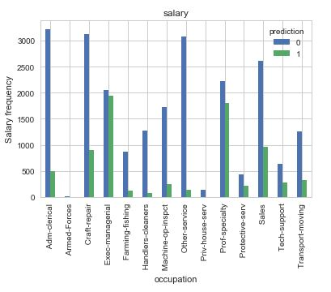
SALARY salary frequency vs occupation

Slide 4
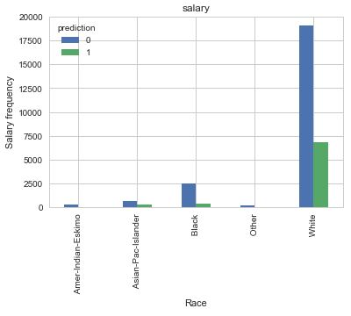
SALARY salary frequency vs race

Slide 5
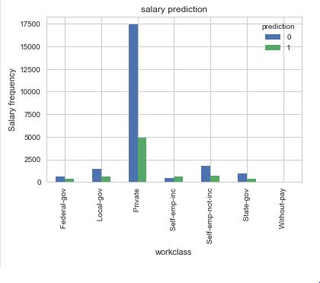
SALARY salary frequency vs workclass

Slide 6
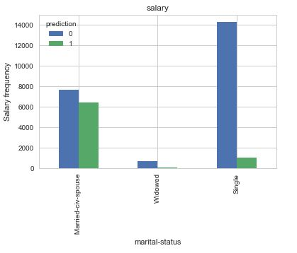
SALARY salary frequency vs marital-status

Slide 7
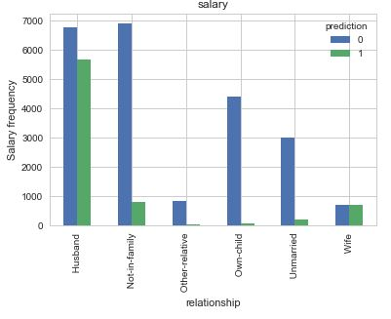
SALARY salary frequency vs relationship

Slide 8
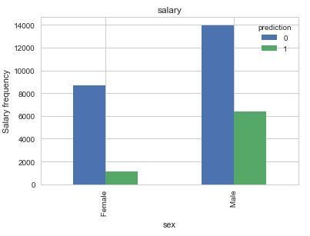
SALARY salary frequency vs sex

Slide 9

CROSS VALIDATION AND COLLISION MATRIX

Slide 10
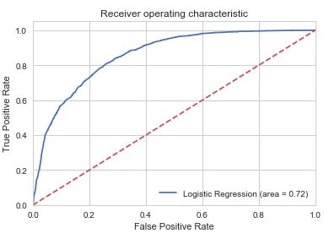
ROC

Slide 11

SUMMARY OF DATA

